Slide 1
PROJECT DEEP LEARNING:-
BRAIN TUMOR MRI
DATE:- 18/7/2025

Slide 2
Name:- Abdelrahman Mohamed Hafez.
Implementation tool: Python + Google Colab

Slide 3
TABLE OF CONTENTS:-
01
02
Introduction / Problem Statement
03
Objectives / Goals
Dataset Description
04
05
Data Preprocessing
Model Selection & Pipeline
07
06
08
Results & Findings
Training and Evaluation
Conclusion And Photos

Slide 4
1. INTRODUCTION / PROBLEM STATEMENT:-
WHAT’S THE PROBLEM?
DETECTING THE PRESENCE OF BRAIN TUMORS USING MRI IMAGES.
WHY IS IT IMPORTANT?
EARLY DETECTION OF BRAIN TUMORS CAN SAVE LIVES AND IMPROVE TREATMENT OUTCOMES.
AUTOMATING DIAGNOSIS WITH DEEP LEARNING REDUCES HUMAN ERROR AND SPEEDS UP THE PROCESS.
GOAL: BUILD A DL MODEL THAT CAN CLASSIFY MRIS INTO "TUMOR" OR "NO TUMOR".

Slide 5
2. OBJECTIVES / GOALS:
Build a Deep Learning classification model using CNN
Achieve at least 80% test accuracy
Experiment with both:
  A custom CNN model
  A pre-trained model (VGG16 - Transfer Learning)

Slide 6
3. DATASET DESCRIPTION:
Dataset name: Brain Tumor MRI
Classes: 2 (Yes - Tumor, No - No Tumor)
Images Size: Resized to 128×128
Total images: Around 3000+ split across two folders

Slide 7
4.DATA PREPROCESSING
Cleaning: Skipped unreadable or damaged files
Normalization: Pixel values scaled between 0 and 1
Augmentation: Applied random transformations to increase diversity
  Rotation, flipping, shifting, zooming
Splitting:
  70% training
  15% validation
  15% testing

Slide 8
5. MODEL SELECTION & PIPELINE
Custom CNN:
2 Conv2D layers + MaxPooling
Flatten → Dense (128) → Dropout → Dense(2, softmax)
Activation: ReLU, Softmax
Loss: Categorical Crossentropy
Optimizer: Adam
VGG16 Transfer Learning:
Pre-trained VGG16 as feature extractor
Added custom dense layers
Only top layers trained (base frozen)

Slide 9
6. TRAINING AND EVALUATION
Epochs: CNN (20), VGG16 (10)
Batch Size: 32
Callbacks: EarlyStopping, ReduceLROnPlateau, ModelCheckpoint
Metrics used: Accuracy, Precision, Recall, F1-score
Evaluation Visuals:
Accuracy / Loss Curves
Confusion Matrix
Classification Report

Slide 10
7. RESULTS & FINDINGS
CNN Model: Accuracy: ~88.00%
Good generalization and learning
Strong performance with basic architecture
VGG16 Transfer Learning: Accuracy: ~91.56%
Outperformed basic CNN
Learned complex features using pretrained layers
Unexpected finding: Even simple CNN gave very high accuracy — shows that even basic deep learning works well with clean, labeled medical data.

Slide 11
8. CONCLUSION AND PHOTOS
Deep Learning models can accurately detect brain tumors from MRI images
Transfer learning (VGG16) gives excellent results with less training
The pipeline is efficient and can be used in medical applications
Future Work / Enhancements:-
Add more data (different tumor types)
Use Grad-CAM to visualize which part of the brain the model focused on
Deploy model via web app or mobile interface

Slide 12
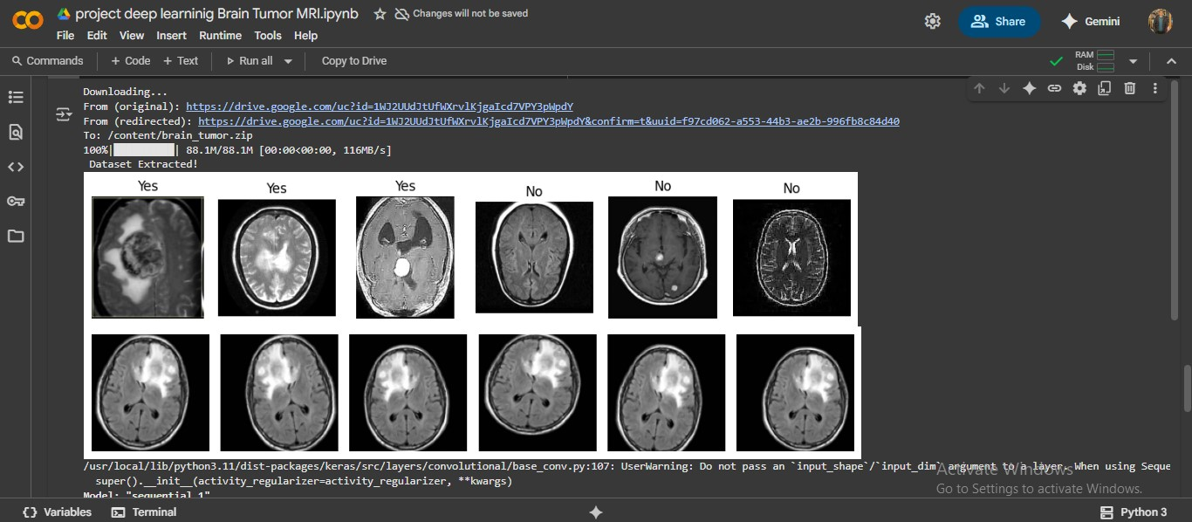
Cont.

Slide 13
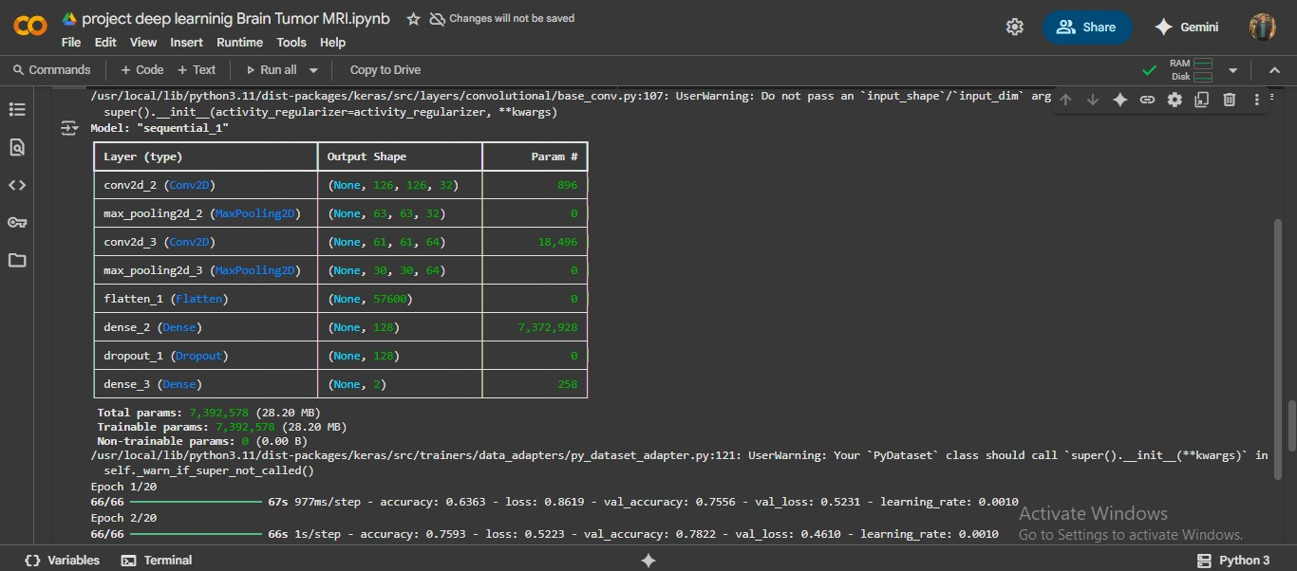

Slide 14
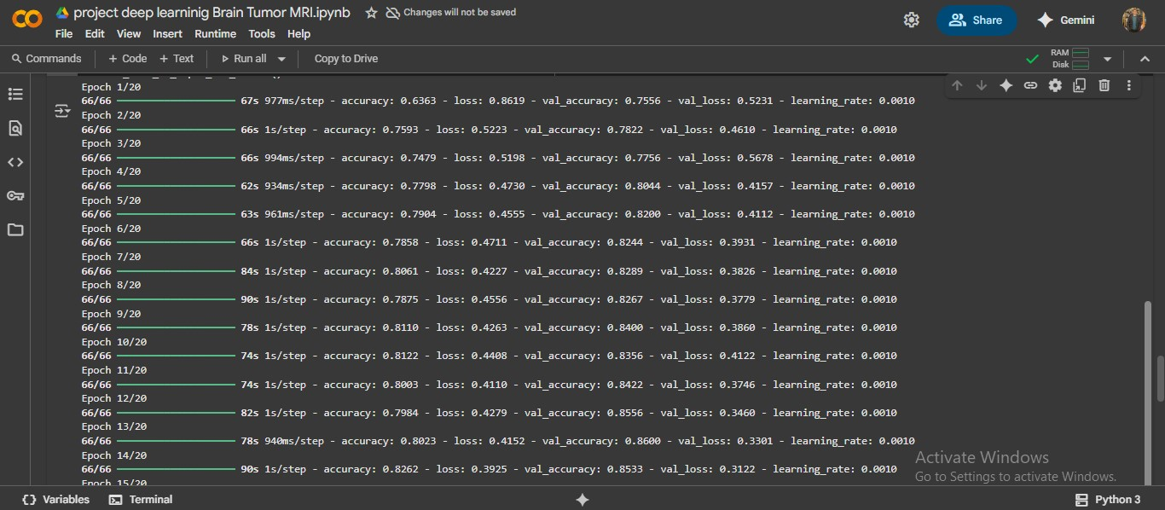

Slide 15
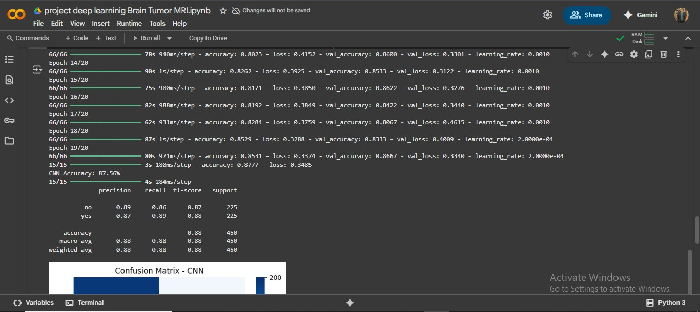

Slide 16
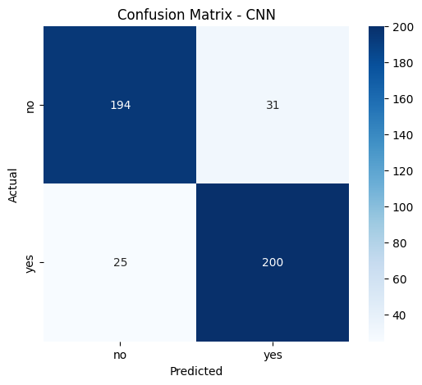

Slide 17
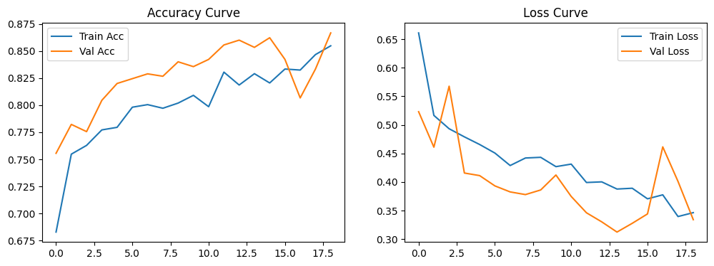

Slide 18
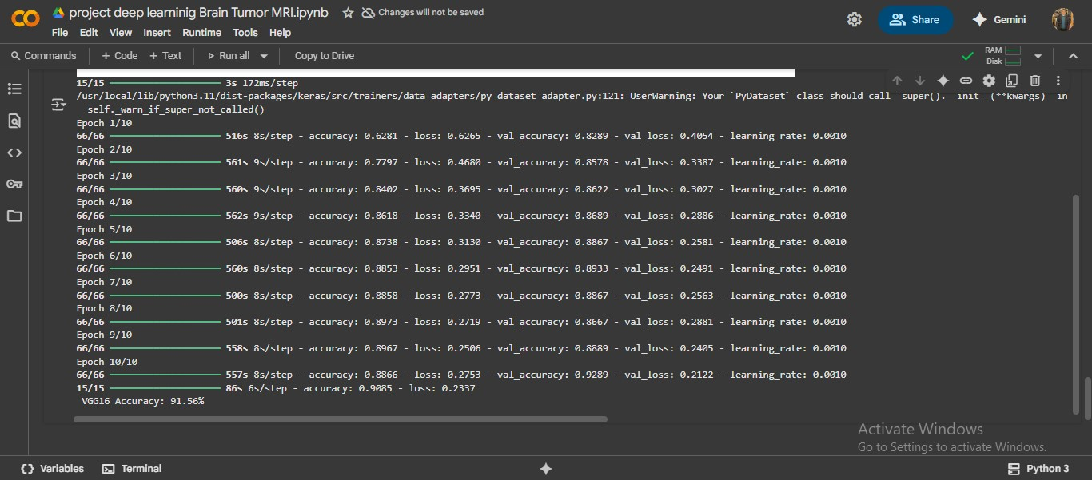

Slide 19
ANY QUESTIONS?

Slide 20
THANK YOU!
THANK YOU ENG: Mohamed Yousef
THANK YOU ENG: RAWAN
BY: Abdelrahman Mohamed Hafez.

